Slide 1









PLATINUM SPONSOR
GOLD SPONSORS
SILVER SPONSOR
BRONZE SPONSOR
STRATEGIC PARTNER

Slide 2
Web scraping practical guide
Sławomir Drzymała

Slide 3






About me
Sławomir Drzymała
Business Intelligence Consultant
Speaker & member of PLSSUG
Speaker at the conferences
Organizer (meetups, hackathon's)
Cofounder of seequality.net
Microsoft Technology enthusiast…
sdrzymala
seequality
SDrzymala
slawomirdrzymala@outlook.com
sdrzymala

Slide 4
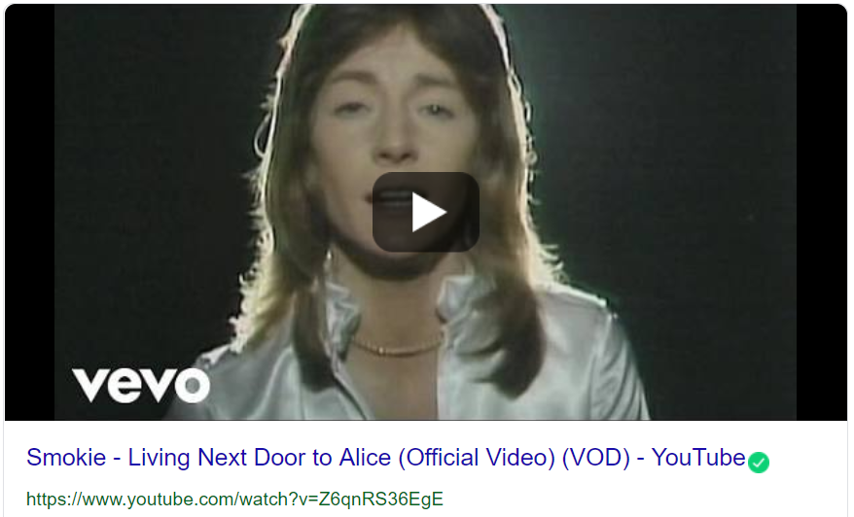
A.L.I.C.E. ?

Slide 5
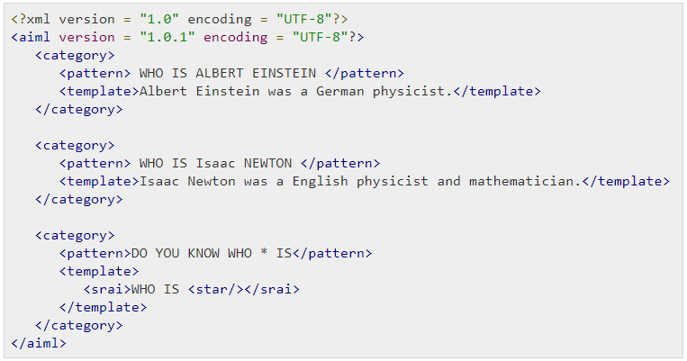
A.L.I.C.E. ?
(Artificial Linguistic Internet Computer Entity) also referred to as Alicebot, or simply Alice is a natural language processing chatterbot (wiki)

Slide 6
Idea
Web scrapping was always a thing for me…
Chatbot knowledge database
Many freelancers websites
Culinary recipes helper
Microsoft Ignite twitter analysis
PowerBI report’s errors
SQL-Saturday, Channel9, sqlbits, etc…
Reason 1 - can be used to get the data from web
Reason 2 - because can be used to automate the boring stuff too
Wanted to share some thoughts and experience
It’s getting popular and It’s relatively easy

Slide 7
For what / business cases
Product and price research
Market research
Aggregators
Comparison engines
Brand loyalty
Use cases [here] and [here]

Slide 8
Agenda
Theory [10 minutes]
Demo [45 minutes]
Recap and Q&A [5 minutes]
Goal is to show different methods, tools, techniques and the way of thinking to scrap the data efficiently. Also to show that it’s easy…

Slide 9
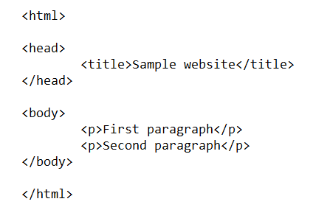

Basics
Web scraping – web harvesting, or web data extraction is data scraping used for extracting data from websites [Wiki]
Web crawling/Crawler – process, (spider, spiderbot) is an Internet bot that systematically browses the WWW [Wiki]
API
HTML
Structured (or not) data
HTML
Parsing
HTML
Insight

Slide 10
Process
Four main steps
First two really related to the web scraping topic
Get HTML
Parse HTML
Save the data
Get insight

Slide 11
Getting data
API – limits, price…
JavaScript – problem with rendering, timing
Captcha – avoiding, completing
Login – interaction with page
Crawling – time, concurrency
Getting source page html could be done manually as well

Slide 12
Parsing
Relatively easy, but…
Be prepared that the web structure might change
Structure might differ between subpages
JavaSript…
Frames…

Slide 13
Save the data
Easy…
Save to files
Save to database
Save to …

Slide 14
Get insight
Extract information
Data quality
Missing data…
Incorrect data…
Data preparation and cleaning
Programming, T-SQL
Tools like Microsoft DQS

Slide 15
What’s needed
Tool and/or programming language + library
Basic knowledge of
HTML
CSS
JS

Slide 16
DEMO????
Web scraping using Power BI Desktop, Pytohn and .NET

Slide 17
Legal or illegal?
Not illegal per se, but can lead to…
Depends on the country….
Always read “Terms and conditions”
Create light crawlers
Follow the guidelines to avoid detection
Web Scraping: Avoiding Detection
How to prevent getting blacklisted while scraping
Be careful, there is many stories…

Slide 18
DEMO
Web scraping using Power BI Desktop, Pytohn and .NET

Slide 19
Demo
Power BI
Native
R (Rvest)
Python (Requests, BeautifulSoup)
.NET
HTML Agility Pack
Selenium
Python
Requests
BeautifulSoup
Selenium

Slide 20
There is more tools and libs
There is many more libraries, frameworks and tools avaliable
Wikipedia:
Check it out
cURL
Data Toolbar
Diffbot
Heritrix
HtmlUnit
HTTrack
iMacros
Selenium (software)
Jaxer
Mozenda
nokogiri
OutWit Hub
watirWget
WSO2 Mashup Server
Yahoo! Query Language

Slide 21
Recap
Web scraping is easy…
Basic programming skills
Basic knowledge of HTML, CSS, JavaScript
If you learn how to scrape the website you will be able to:
get any data from any website
automate some boring tasks
Have fun
There is plenty of tools and libraries available

Slide 22
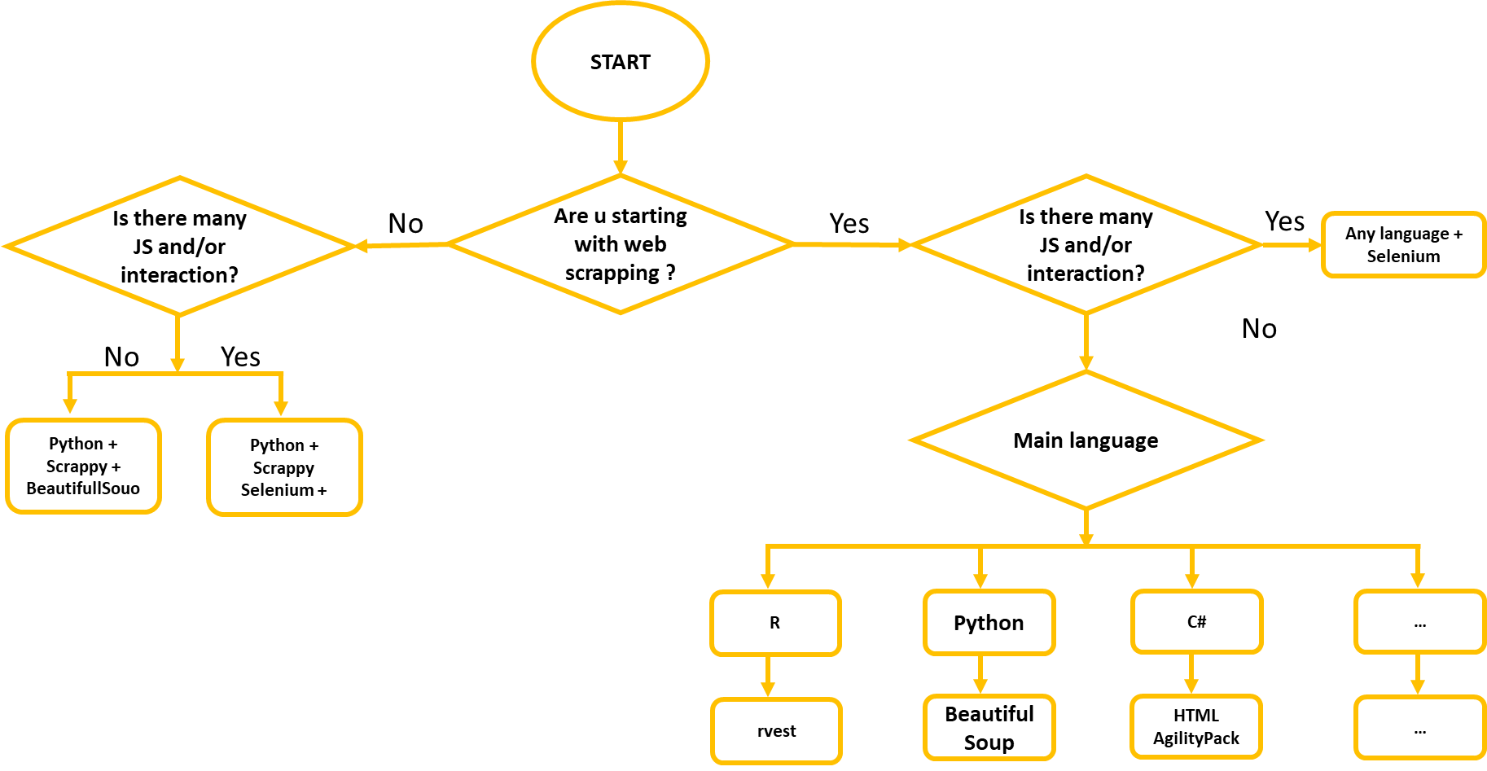
Cheatsheet

Slide 23
What to know more?
Get the presentation
Seequality – [1]
Power BI – [1] [2] [3]
C# - [1] [2] [3]
Python – [1] [2] [3]
General - [1] [2] [3]
Experiment yourself

Slide 24
Web scraping practical guide
Sławomir Drzymała
https://github.com/sdrzymala/WebScrappingPracticalGuide
slawomirdrzymala@outlook.com
sdrzymala
SDrzymala

Slide 25
PLATINUM SPONSOR
GOLD SPONSORS
SILVER SPONSOR
BRONZE SPONSOR
STRATEGIC PARTNER

